Slide 1
Sample Store Analysis
Done By : Chandra Prakash Mewari

Slide 2
Sample Store Columns:
Ship Mode : Under Different Class
Segment : Different Segments of Users.
Country : Types of Country
City : Types of City
State : Types of State
Postal Code: Under Various City Postal Code
Category : Different Types Of Store Categories
Sub-Category : Under Various Sub Categories
Sales : Different Sales By Store
Quantity : Number of Quantity That are saled or Left
Discount : Discount Price of that was Given By Store
Profit : Under there Different Profits.

Slide 3
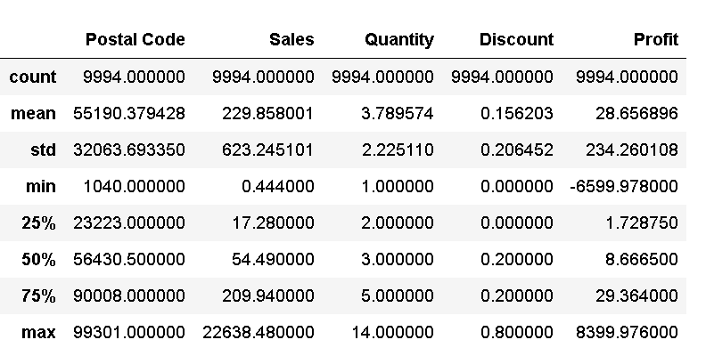
Shape and Description of the data :
It Contains 9994 rows, 13 Columns.

Slide 4
Ship Mode Count

Slide 5
Analysis on ship mode count graph
From this graph we can easily recognize that most of shipping happened in standard class mode.
Secondly we can recognize that least of shipping happened in same day mode.

Slide 6
Segment Count

Slide 7
Analysis on segment graph
We can analyze from the graph that most of the product purchased by consumer segment.
Secondly we can analyze from the graph that least of the product purchased by home office segment.

Slide 8
Country By States:-

Slide 9
Analysis on city graph
From this state graph we can see most of the product sales in between Noblesvile and Newalbary city.
Next we can see least of the product sales in Wilson city ,Utica and west Jordan.

Slide 10
State Count:-

Slide 11
Analysis on state graph
In this graph we can analyze that most of the product sales in Arkanasas state.
From this graph we can also recognize least of the product sales in Idaho state.

Slide 12
Region Count :-

Slide 13
Analysis on region graph
In this graph we can analyse that heighest percentage of product sales in west region and the percentage is 3203,32%
We can also analyse that lowest percentage of product sales in south region and the percentage is 1620,26

Slide 14
Types of Categories :-

Slide 15
Analysis on categories graph
From this graph we can know about the product categories .Basically
It shows there are three type of categories .
We can easily analyse that most of the product sales in office supplies category.
Second thing we can analyse that least of the product sales in technology category.

Slide 16
Categories and Sub-Categories Count:-

Slide 17
Analysis on subcategory graph
From this graph we can see the different kind of product present in each category of product.
First we can analyze that in furniture category most of the product sales in fumishing subcategory and least of the product sales in bookcases subcategory.
Second we can analyze that in office supplies category most of the product sales in binders and least one is supplies.
Third we can analyze that in technology category most of the product sales in phones and least one is coppiers.

Slide 18
Profit By Region :

Slide 19
Analysis on profit by region graph
From this graph we can analyze that highest profit occurred in west region of the country.
Second thing we can analyze that least profit occurred in south region of the country.

Slide 20
Region Where Less Profit:-

Slide 21
Analysis on less profit region graph
From this graph we can analyze that less profit occurred in south region of the country.
Second less profit occurred in east region of the country.

Slide 22
IMPROVEMENT
We can Work on Different Region to Improve Our Sales
Also We can Increase Our Quantity and Discount to increase sales.

Slide 23
xddd
THANK YOU

